Slide 1
Tic-Tac-Toe game with Flask and GPT-2
Jaehyeok Hyun

Slide 2
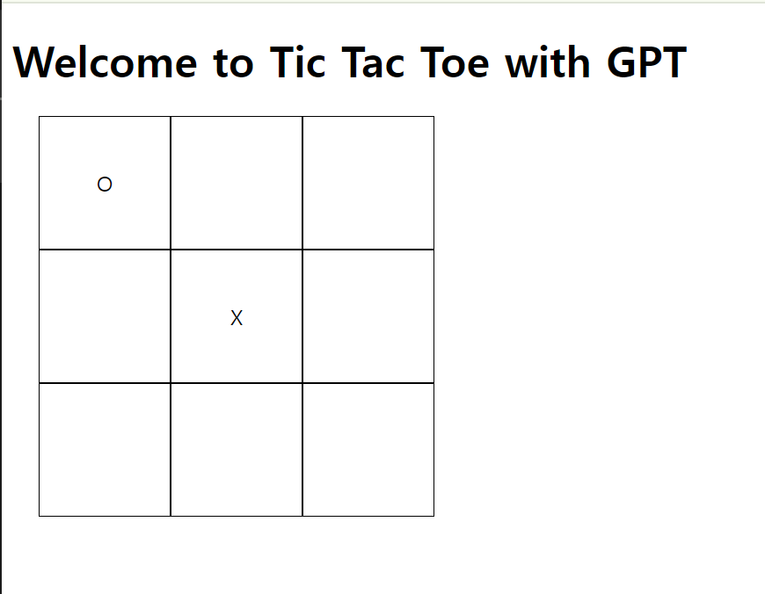
Developing TTT web applications using Flask
Use Flask to develop TTT web application
Use GPT-2 model as an AI opponent

Slide 3
AI Problem
Goal: let AI plays TTT effectively to win or draw
Performance improvement using caching
Current Project: using a random algorithm to place moves in empty spaces

Slide 4
Solution
Encode the current TTT board state into a text prompt
AI put next moves in empty spaces
Fast response and easy to implement
Limitations
Lack of strategy
AI puts moves randomly

Slide 5
Research Quesitons
What’s the win/draw rate of this random TTT Ai
Does caching improve the response time?

Slide 6
Experiments and Methodology
Testing the random AI on various states to evaluate
Measuring response times with and without caching

Slide 7
Results
Random AI has limitations in making strategic decisions
Caching significantly improves performance
Better AI strategy is mandatory

